Slide 1
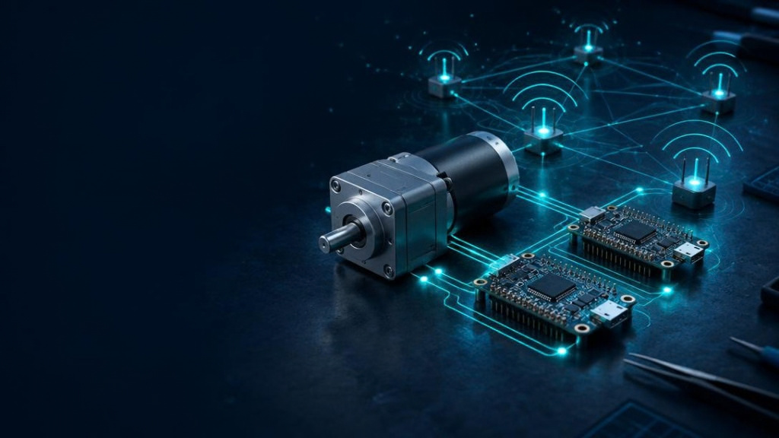

GRADUATION PROJECT / EMBEDDED SYSTEMS
Embedded Wireless
Motor Monitoring
& Control System
Real-Time Closed-Loop Control, Fault Detection & Wireless Telemetry
EMBEDDED WIRELESS MOTOR SYSTEM
01

Slide 2
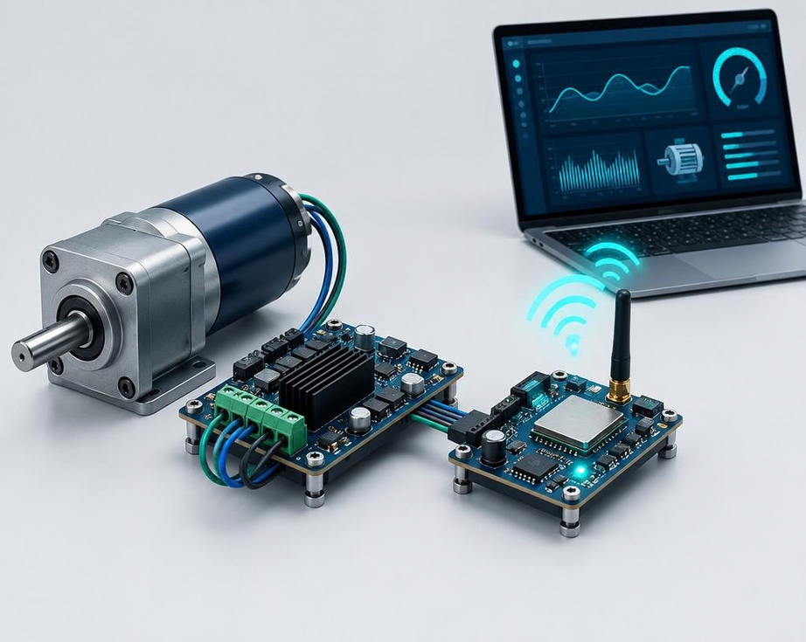
02 / CONCEPT
Two Controllers. One Deterministic System.
ATmega32
Real-time safety, PWM motor control, encoder feedback and sensor acquisition.
ESP32
Wi-Fi telemetry gateway and live web monitoring — without disturbing the control loop.
LOW-COST • RELIABLE • AUTOMATED SAFETY
EMBEDDED WIRELESS MOTOR SYSTEM
03

Slide 3
03 / ARCHITECTURE
System Architecture & Data Flow
ENCODER • IMU
NTC ×2 • VOLTAGE
ULTRASONIC
UART 5V ↔ 3.3V
ATmega32
REAL-TIME CORE
2-CH LEVEL
CONVERTER
ESP32
WI-FI GATEWAY
LAPTOP
DASHBOARD
ADC / I²C / INTERRUPTS
PWM + DIRECTION
L298N DRIVER
+ 12V GEAR MOTOR
EMBEDDED WIRELESS MOTOR SYSTEM
04

Slide 4
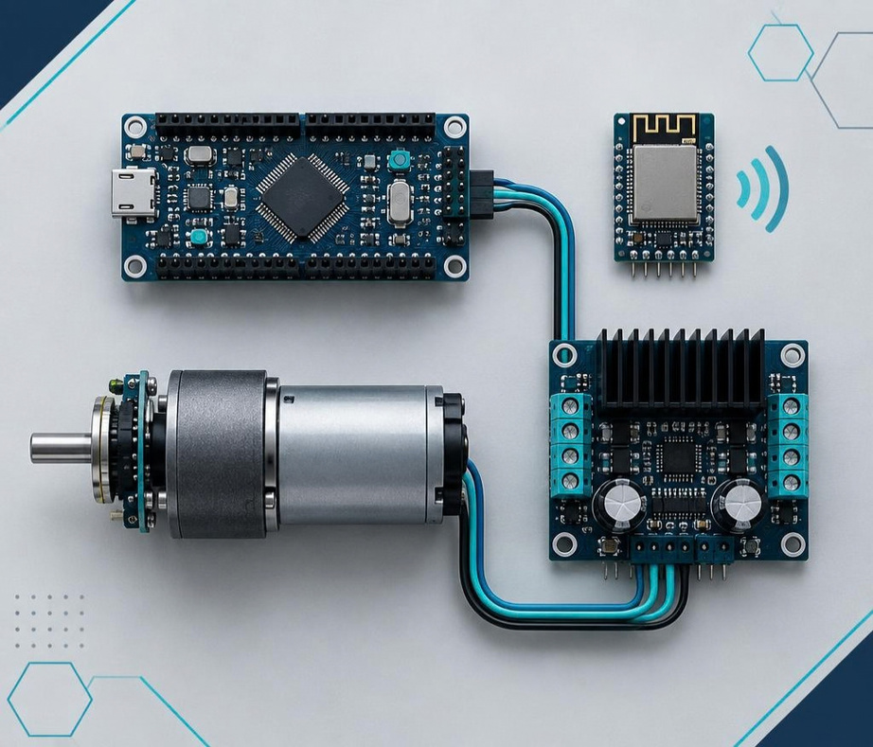
04 / HARDWARE
Processing & Actuation Hardware
ATmega32 Board
PWM • ADC • interrupts • timers • safety logic
ESP32 Board
Serial telemetry • Wi-Fi web server
25GA370 Gear Motor
12V • 210 RPM • quadrature encoder
L298N Driver
Bi-directional H-bridge actuation
EMBEDDED WIRELESS MOTOR SYSTEM
05

Slide 5
05 / SENSING
Five Signals. One Health Picture.
RPM
6-DOF
°C ×2
VDC
RANGE
Quadrature Encoder
MPU6050 IMU
NTC Thermistors
Voltage Sensor
Ultrasonic
Closed-loop speed feedback
Vibration & angular motion
Motor + driver temperature
Supply rail monitoring
Obstacle safety threshold
EMBEDDED WIRELESS MOTOR SYSTEM
06

Slide 6
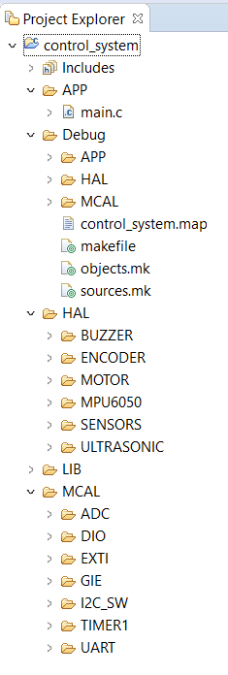
Layered Firmware Architecture
Application Layer (APP)
Hardware Abstraction Layer (HAL)
Libraries (LIB)
Microcontroller Abstraction Layer (MCAL)

Slide 7
06 / COMMUNICATION
A Safer, Simpler UART Bridge
TX
ATmega32
5V LOGIC
BI-DIRECTIONAL
LEVEL CONVERTER
5V ↔ 3.3V
ESP32
3.3V LOGIC
RX
Direct full-duplex UART replaces the legacy RS-485 stage — fewer ICs, no termination network, smaller footprint.
EMBEDDED WIRELESS MOTOR SYSTEM
07

Slide 8
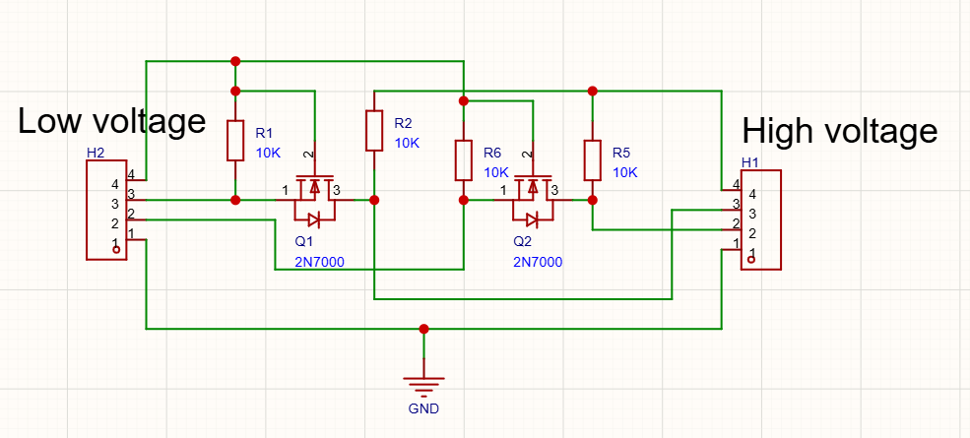

Slide 9
07 / POWER
Power Integrity from 12V to Logic Rails
5V RAIL
MCU • SENSORS
12V DC
2–3A
FUSE +
BUFFERING
LM2596
12V → 5V
3.3V REGULATOR
ESP32 +
LEVEL SHIFT
470–1000µF + 100µF
100nF CERAMIC
Startup-current buffering & low-frequency decoupling
High-frequency noise suppression at each logic rail
EMBEDDED WIRELESS MOTOR SYSTEM
08

Slide 10
08 / SAFETY
Autonomous Decisions — No Network Required
CONTINUOUS CLOSED-LOOP MONITORING
OBSTACLE WITHIN
SAFETY RANGE?
RPM BELOW THRESHOLD
UNDER LOAD?
NORMAL
OPERATION
IMMEDIATE STOP
+ ACTIVE BUZZER
WARNING BUZZER
+ FAULT FLAG
EMBEDDED WIRELESS MOTOR SYSTEM
09

Slide 11
09 / FIRMWARE
Deterministic Control Meets Connected Telemetry
ATmega32
ESP32
REAL-TIME CONTROL PLANE
WIRELESS APPLICATION PLANE
PWM speed regulation
Timer ISR encoder counting
ADC: NTC + voltage
I²C: MPU6050 vibration
UART packet serialization
Receive serial packets
Validate and parse telemetry
Host Wi-Fi web server
Update live dashboard
Publish status + fault flags
EMBEDDED WIRELESS MOTOR SYSTEM
10

Slide 12
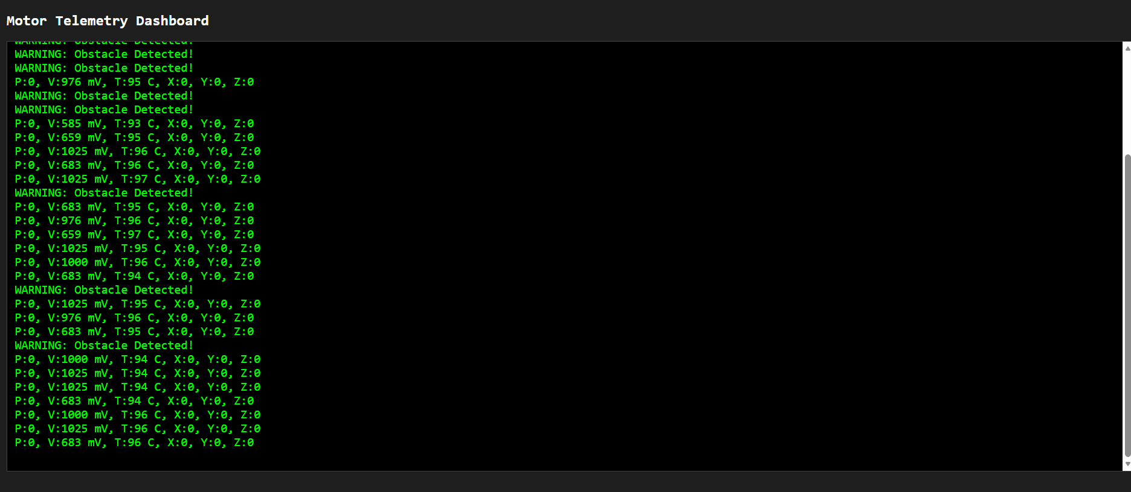

Slide 13
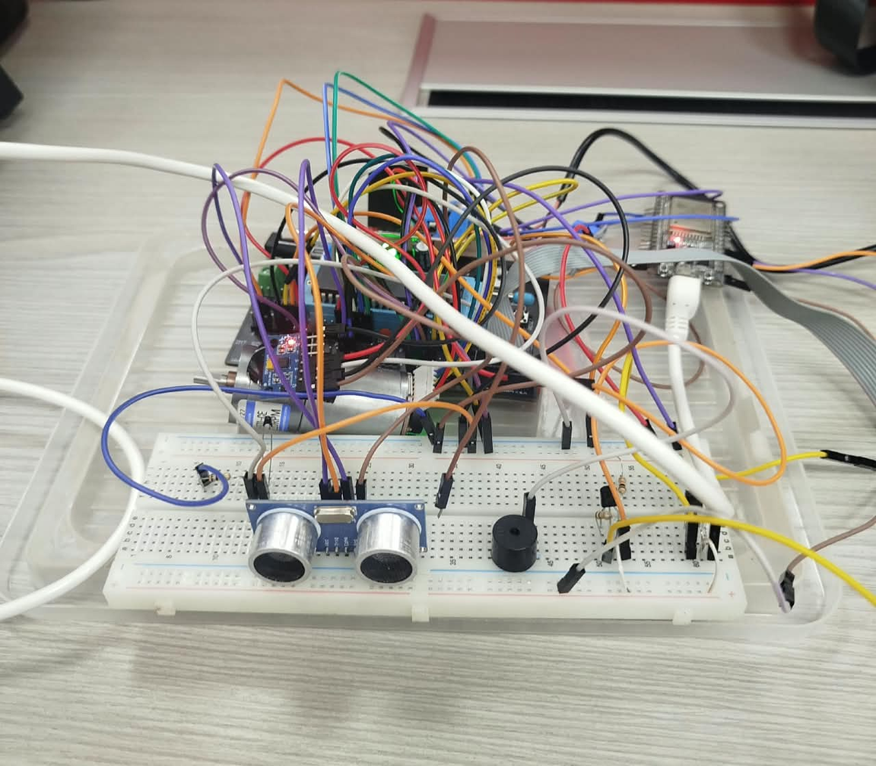
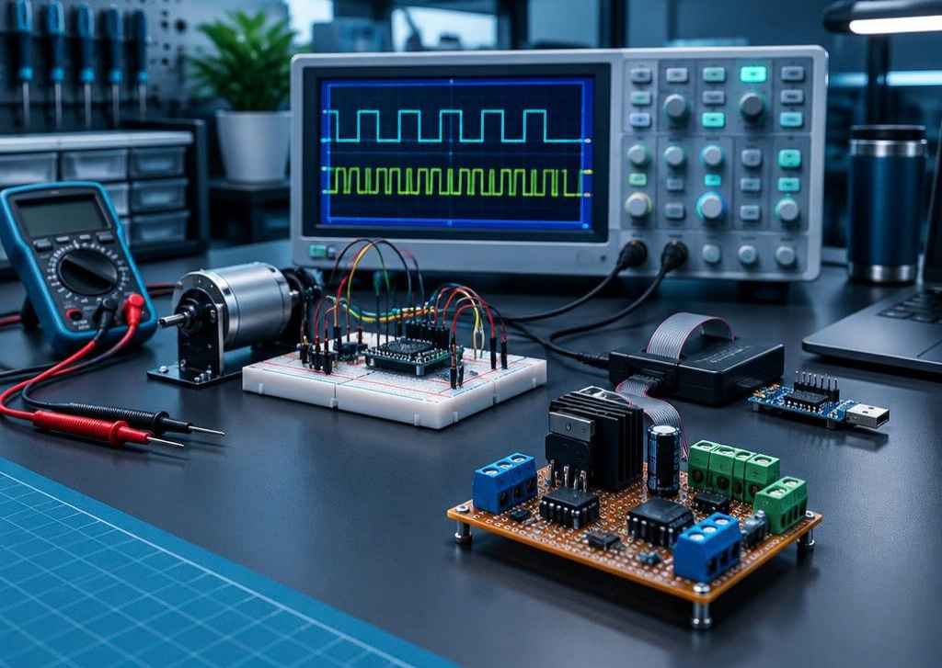
10 / VALIDATION
From Breadboard to Enclosure
01
BREADBOARD
Circuit + signal validation
02
PROGRAM & DEBUG
Programmer + serial console
03
INSTRUMENT
PWM • encoder • UART
04
FINAL BUILD
Perfboard + enclosure
EMBEDDED WIRELESS MOTOR SYSTEM
11

Slide 14
11 / OPTIMIZATION
Less Hardware. More Capability.
BEFORE
AFTER
RS-485 + MAX485 + termination
Direct UART + safe level conversion
Local 16×2 LCD
Wireless laptop dashboard
Motor without precise feedback
210 RPM gear motor + encoder
Redundant diodes + MOSFETs
Streamlined validated passives
EMBEDDED WIRELESS MOTOR SYSTEM
12

Slide 15
01 / PEOPLE
Project Team & Supervision
AA
MA
MW
Adham Abdel Kader
Mohamed Ali
Mahmoud Wael
Hardware & PCB Design
Wireless & Dashboard
Embedded Firmware Lead
SUPERVISED BY
Eng. Basel Dawood
Eng. Ablelrahman Ali
EMBEDDED WIRELESS MOTOR SYSTEM
02

Slide 16

CONCLUSION / FUTURE SCOPE
Control locally.
Monitor anywhere.
Validated real-time motor control, condition monitoring and autonomous safety in a cost-effective dual-controller platform.
NEXT / MQTT cloud integration • AI predictive maintenance from vibration data
Thank You!
Open for Questions & Discussion.
EMBEDDED WIRELESS MOTOR SYSTEM
13

